Slide 1








Rapido Bike Trip EDA

Slide 2





Introduction
In this Exploratory Data Analysis (EDA), we delve into Rapido Bike's trip data to uncover insights crucial for optimizing urban mobility. By analyzing rider behavior, trip durations, popular routes, and peak hours, we aim to enhance service quality and customer satisfaction. Through data-driven approaches, we seek to contribute to the evolution of ride-hailing services, promoting efficiency and sustainability in urban transportation ecosystems.

Slide 3





Objectives

Slide 4



Objectives
1
2
3
Customer Behavior Analysis: Investigate customer preferences, including trip durations, destination choices, and frequency of rides, to tailor services and marketing strategies for improved customer satisfaction and retention.
Identify Peak Hours: Analyze the data to determine the busiest hours and days for Rapido Bike trips, enabling better resource allocation and service optimization to meet demand fluctuations.
Route Optimization: Identify popular routes and areas with high trip frequency to optimize rider deployment, reduce wait times, and enhance overall efficiency.

Slide 5
Objectives
4
5
Safety Enhancement: Analyze accident/incident data to identify patterns and hotspots, allowing for targeted safety measures and rider training programs to mitigate risks and enhance safety standards.
Performance Evaluation: Evaluate key performance metrics such as average trip duration, rider utilization rates, and customer ratings to assess the effectiveness of operational strategies and identify areas for improvement.

Slide 6







Data collection
Data collection for Rapido Bike Trip EDA involves gathering various datasets related to the company's operations. Here are some key data sources:
Trip Data: Information on individual bike trips, including timestamps, start and end locations, distance traveled, trip duration, fare charges, and rider details.
Geospatial Data: Geographic information detailing the road networks, traffic patterns, and spatial distribution of pick-up and drop-off locations to analyze route efficiency and identify popular areas.
Rider Data: Details about Rapido riders, including demographics, experience level, ratings, performance metrics, and any feedback or complaints received.
Customer Feedback: Feedback and ratings provided by customers after each trip, capturing satisfaction levels, suggestions for improvement, and any issues encountered during the ride.

Slide 7
Accident/Incident Reports: Records of any accidents, incidents, or safety-related concerns during bike trips, including details such as location, time, severity, and causes.
Weather Data: Historical weather information such as temperature, precipitation, and wind speed, which may impact rider behavior, trip demand, and overall service performance.
Operational Data: Information on operational parameters such as bike availability, rider availability, peak hours, and service coverage areas to analyze service dynamics and optimize resource allocation.
Competitor Analysis: Data on competing bike taxi services, market share, pricing strategies, and customer preferences to benchmark Rapido's performance and identify areas for differentiation.

Slide 8


Data Preprocessing
Handling Missing Values: Identify and handle missing values in the dataset, either by imputing them using appropriate techniques such as mean, median, or mode, or by removing the affected records if the missing values are substantial.
Data Cleaning: Cleanse the data by removing any inconsistencies, outliers, or errors that may skew the analysis results. This includes checking for duplicates, correcting erroneous entries, and standardizing formats across variables.
Feature Engineering: Create new features or derive additional information from existing ones to enhance the analysis. For example, extracting date and time components from timestamps, calculating trip distances using geographical coordinates, or categorizing data into relevant groups for easier analysis.
Normalization and Scaling: Normalize or scale numerical features to ensure that they are on a comparable scale, preventing bias in models that rely on distance measures or magnitude-sensitive algorithms.

Slide 9
Handling Categorical Variables: Encode categorical variables into numerical representations using techniques such as one-hot encoding or label encoding to make them suitable for analysis by machine learning algorithms.
Data Integration: Integrate data from multiple sources if necessary, ensuring consistency and compatibility across datasets for a comprehensive analysis.
Data Reduction: Reduce dimensionality if dealing with high-dimensional datasets by employing techniques like principal component analysis (PCA) or feature selection methods to retain the most informative variables while reducing computational complexity.
Data Sampling: Balance imbalanced datasets by oversampling minority classes or undersampling majority classes to ensure fair representation and prevent bias in the analysis.

Slide 10
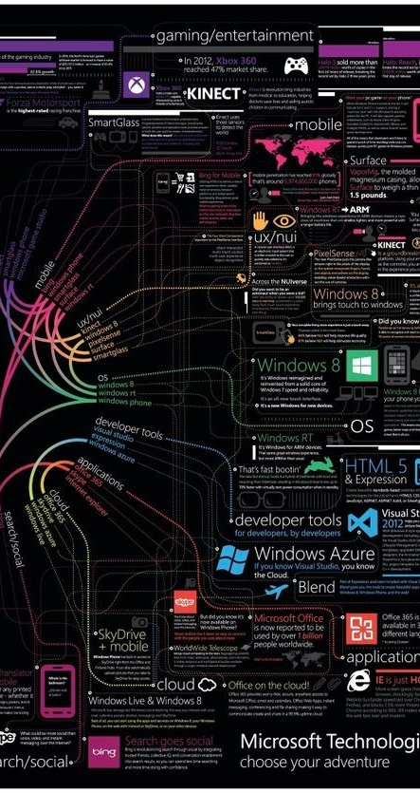
Data Analysis & Reporting with python
Data Loading: Start by loading the preprocessed Rapido Bike trip data into Python using libraries such as Pandas. This step involves reading the data from CSV files or databases into DataFrame objects.
Exploratory Data Analysis (EDA): Conduct EDA to understand the dataset's structure, distribution, and relationships. Use descriptive statistics, data visualization techniques (e.g., histograms, box plots, scatter plots), and correlation analysis to explore variables and identify patterns.
Feature Engineering: Create new features or transform existing ones based on insights gained during EDA. This step may involve extracting temporal features from timestamps, computing trip distances, or encoding categorical variables.
Statistical Analysis: Perform statistical tests to investigate hypotheses and assess relationships between variables. Utilize libraries such as SciPy for conducting t-tests, ANOVA, correlation analysis, and regression analysis as needed.

Slide 11

Machine Learning Modeling: Apply machine learning algorithms to predict outcomes or uncover hidden patterns in the data. Use libraries like Scikit-learn to build models for tasks such as customer segmentation, demand forecasting, or rider performance prediction.
Model Evaluation: Evaluate the performance of machine learning models using appropriate metrics such as accuracy, precision, recall, or RMSE (Root Mean Squared Error). Utilize cross-validation techniques to ensure robustness and generalizability of the models.
Reporting: Generate interactive reports and visualizations to communicate key findings and insights. Use libraries like Matplotlib, Seaborn, and Plotly for creating plots, and tools like Jupyter Notebooks or Dash for building interactive dashboards.
Documentation: Document the entire analysis process, including data preprocessing steps, EDA findings, model selection criteria, and evaluation results. Provide clear explanations and interpretations of the findings to facilitate understanding and decision-making.

Slide 12


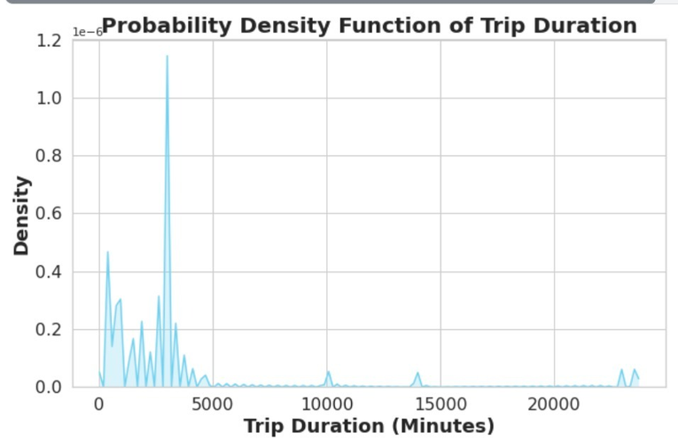


Interpret Results
The probability density function of trip duration in Rapido Bike Trip EDA reveals that most trips cluster around a specific duration, indicating a common pattern in ride lengths. Understanding this distribution enables precise prediction of trip durations, facilitating efficient resource allocation and service optimization for improved customer experience.

Slide 13
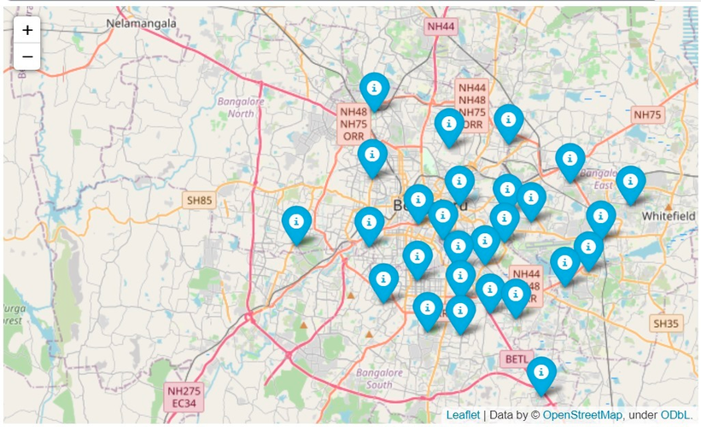
Interpret Results
Tracing location data in Rapido Bike Trip EDA unveils hotspots of rider activity and popular routes, highlighting areas of high demand. This insight aids in optimizing rider deployment, reducing wait times, and enhancing service coverage to meet customer needs efficiently, ultimately improving overall service quality and satisfaction.

Slide 14
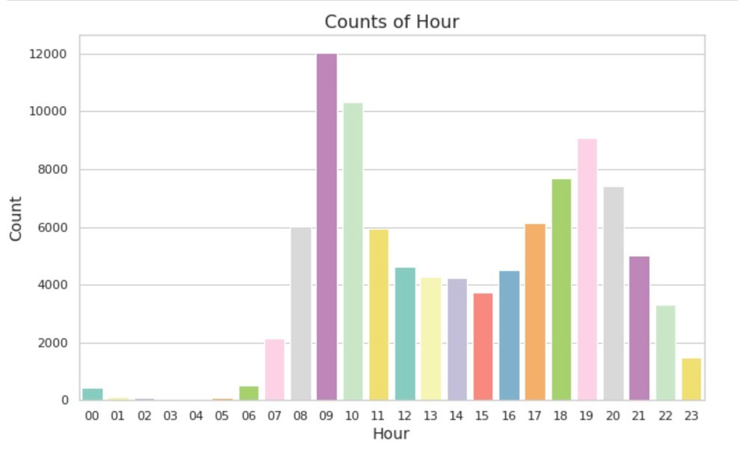
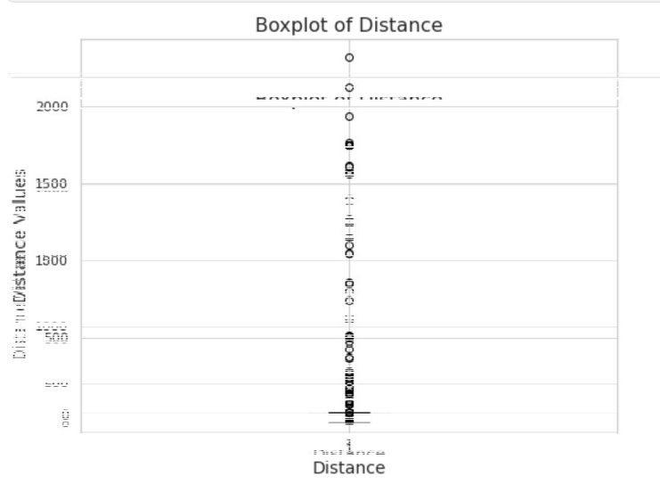
Interpret Results

Slide 15
Conclusion
Rapido Bike Trip EDA has provided invaluable insights into the operational dynamics of the bike taxi service. By analyzing trip data, identifying peak hours, optimizing routes, understanding customer behavior, and enhancing safety measures, stakeholders can make informed decisions to optimize service efficiency and improve customer satisfaction. This analysis underscores the importance of data-driven approaches in shaping the future of urban mobility, fostering innovation, and driving sustainable growth in the transportation sector.

Slide 16
Actionable Recommendations
Customer Engagement: Develop personalized marketing campaigns and loyalty programs based on customer preferences and behaviors, fostering customer loyalty and increasing retention rates.
Expansion Opportunities: Identify underserved areas or potential market segments through geospatial analysis and customer segmentation. Explore opportunities for expansion into new markets or introduction of additional services to meet evolving customer needs.

Slide 17




Guided by-
Maheswata
The team
21BCE7650
A.G.Venkata Reddy
21bce8617
A.G.Nanda Kishore Reddy
21bce7610
Duvvuru Guru Sai Sashank
21bce7165
Syamala Krishna Reddy
21bce7462
Yeruva Uday Kiran Reddy
21bce8938
Alampally Sai Teja
21bce9951
Bathula Subhash
21bce8939
B.Rishitha

Slide 18



THANK YOU

